Slide 8

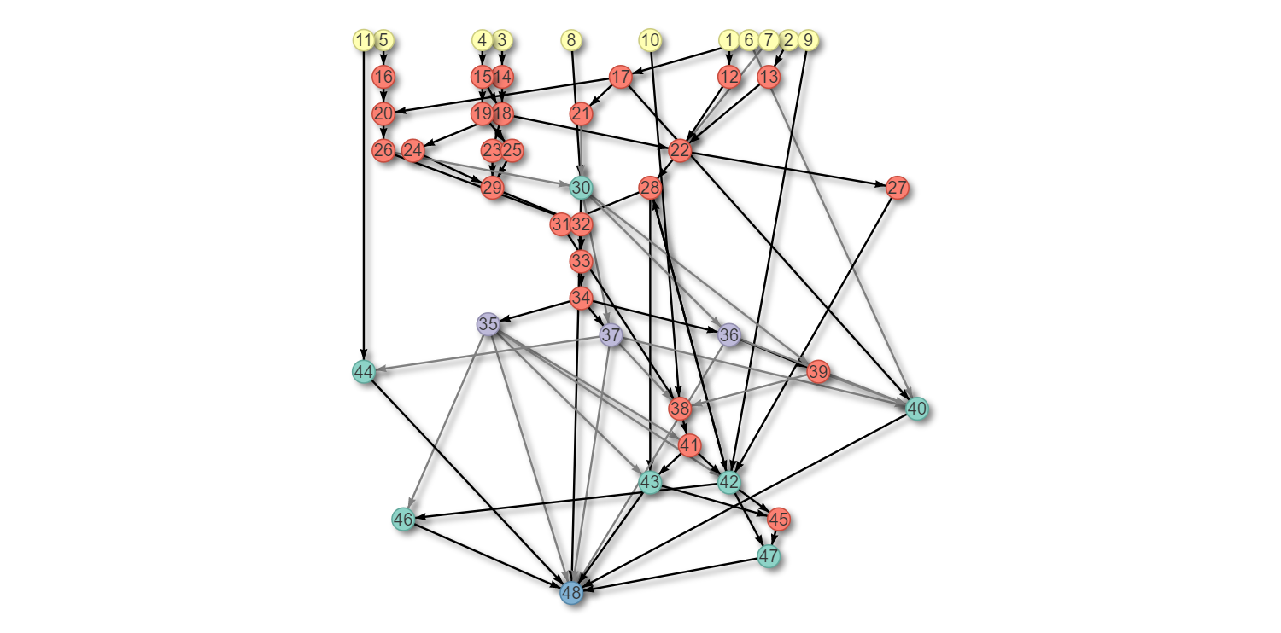
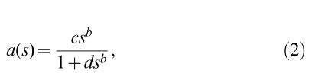
Human apoptosis network
Notes:
If a<0, a=0

Slide 9
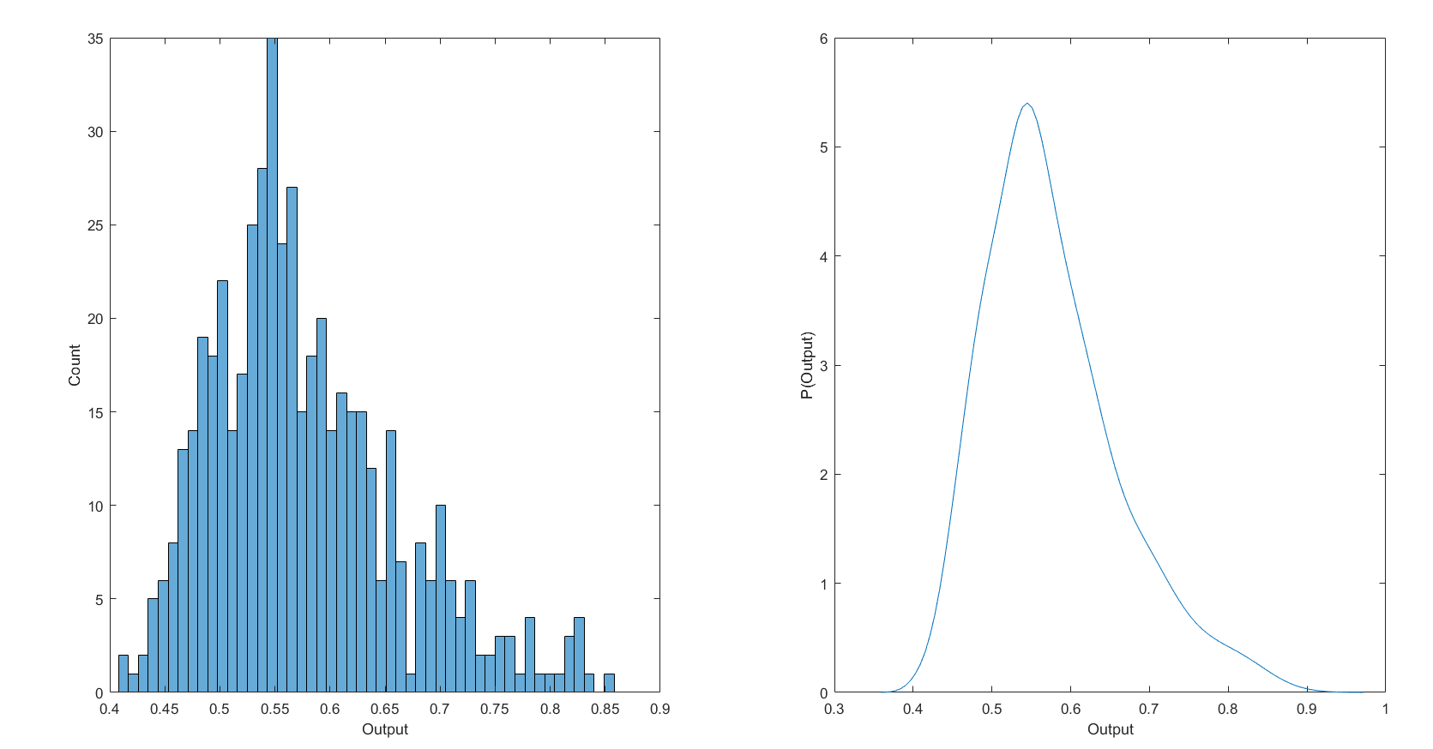
three drug combinaiton
Notes:
c=1.8;
b=2;
d=1;
Input=0-2

